Slide 1

Predicting Depression Levels Using Social Media
By
Yukti Basnet (1AY14CS141)
Under the guidance of
Prof. Sowmya P.
Department of CS & E ,AIT

Slide 2
CONTENTS
Introduction
Comparision of related work
Work Done
Application
Conclusion
References

Slide 3
Introduction
What is the problem ?
Recognition of Medical mining.
Technological Notion .
Solution.

Slide 4
Comparision of related work
M.D.Choudhury, Michael Gamon used social media as a screening tool to predict the MDD level in individuals using Center for Epidemiological Studies Depression Scale) screening test.
Rude et al., introduced measures to characterize posts from users and used P.O.S for determining specific linguistic styles using data mining technique.
Jamil Hussain proposed a tool that predict and diagonise the depression of SNS users regarding their activities in limited period of time.

Slide 5
Work Done
Working forms of Medical Mining:
Natural language processing.
Analysis and identification of information.
Extracting information.
Tokenizing.
Question Module.
Solutions Respectively.

Slide 6
Natural language processing
Transformation of speech input into representative order to analyze various aspects of language.
Ambiguous
Lexical ambiguity(‘noun’ or ‘verb’)
Syntactical ambiguity (parsing)
Referential ambiguity

Slide 7
Components of NLP 1. Natural language understanding(NLU) -Programmed with the ability to understand meaning in spite of common human errors like mispronunciations or transposed letters or words. -Uses algorithms to reduce human speech into a structured ontology. 2 .Natural language generation(NLG) - A translator that converts data into a natural language representation.

Slide 8
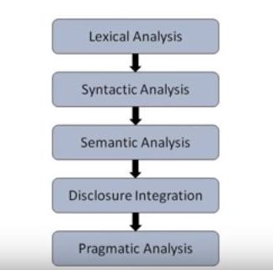
Analysis and identification of information

Slide 9
1. Lexical Analysis : Recognition and identification of structure of sentence. 2. Syntactical Analysis : Parsing of the POS. 3. Semantic Analysis : Relating syntactic structures, from the levels of phrases to language independent meaning. 4. Disclosure Integration : Meaning of sentence verification. 5. Pragmatic Analysis : Reinterpretation of given context of sentences.

Slide 10
Tokenizing
Conversion of sentence into sequence of tokens i.e words.
Why do we u tokenize?
Because we do not want to treat a sentence as a sequence of characters.
Tokenizing general English sentences I relatively straightforward.
Use spaces as the boundaries.

Slide 11
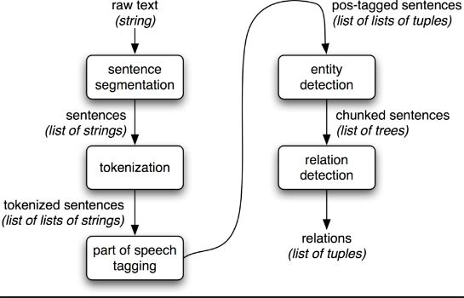

Slide 12
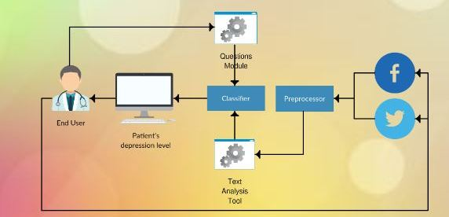
Extracting information

Slide 13
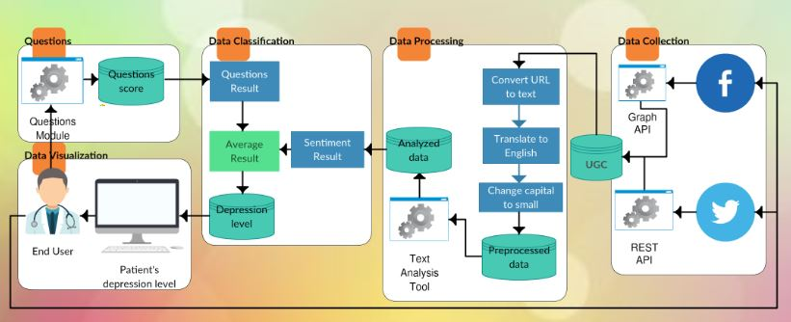

Slide 14
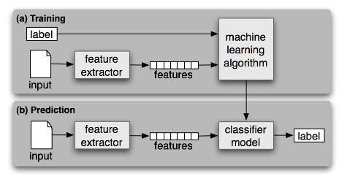
Classifier
Model consists of number of processes to test both SVM classifier and Naïve Bayes classifier.
First dataset is training dataset used to train the depressed and not-depressed posts then testing other section of dataset is done.

Slide 15
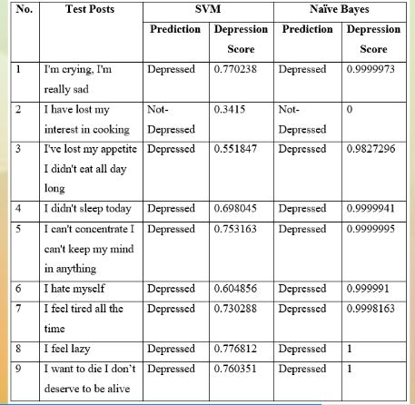

Slide 16
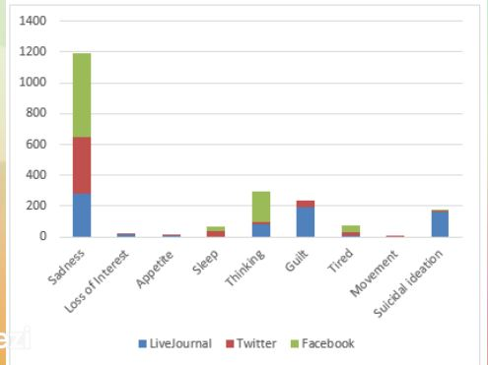

Slide 17
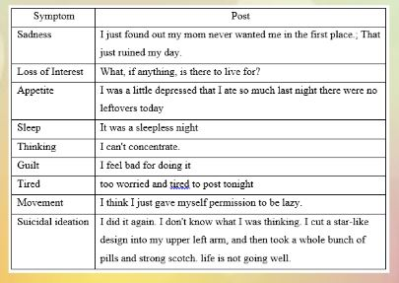

Slide 18
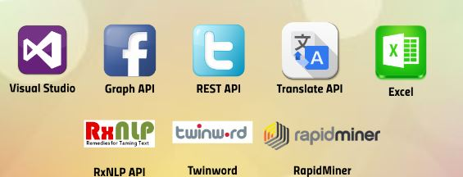
Tools used for Implementation

Slide 19
Applications
Processes to test classifiers like SVM and Naïve Bayes,using Training and Testing dataset.
Tokenizing operators and using POS for as feature set.
Graphical representation of results to the end user.
Questions Module and Solutions accordingly.

Slide 20
Conclusion
The key idea of our study is to propose a web application that can classify SNS user into one out of four depression level,which could be used by psychiatrists,family,and friends of depressed patient.
The web application collects the UGC from the patients Twitter and/or Facebook. It collects comments based on BDI-II questionnaire ,then it analyzes the UGC using text analysis APIs. Classification is done out of four levels(Minimal,Mild,Moderate,or Severe depression)using TwinWord sentiment tool.
Predating model using RapidMiner to test two classifiers(SVM, and Naïve Bayes Classifier).

Slide 21
References
[1] J. M. Torpy, “Generalized anxiety disorder.,” The New England journal of medicine, 2004. [Online]. Available: http://jama.jamanetwork.com/.
[2] I. Yoo, P. Alafaireet, M. Marinov, K. Pena-Hernandez, R. Gopidi, J. F. Chang, and L. Hua, “Data mining in healthcare and biomedicine: A survey of the literature,” J. Med. Syst., vol. 36, no. 4, pp. 2431–2448, 2012.
[3Andrade L, Caraveo-A. Epidemiology of major depressive episodes: Results from the International Consortium of Psychiatric Epidemiology (ICPE) Surveys . Int J Methods Psychiatr Res.12(1):3–21.
[4] Detels, R.The scope and concerns of public health. Oxford University Press..
[5] Beck, A. T.; Steer, R. A.; & Brown, G. K. Manual for the Beck depression inventory-II. San Antonio, TX: Psychological Corporation, 1, 823.

Slide 22
ANY QUESTIONS?

Slide 23
THANK YOU

